Slide 1
COVID 19
SQL Data Exploration Project

Slide 2

COVID 19

Slide 3
Description
This Project is based on Alex Freberg’s SQL Data Exploration Tutorial on YouTube. I have used MySQL Workbench to do this project.
The main objective is to explore the dataset to get some information about COVID-19 cases.

Slide 4
Overview
Data Preview
Total Cases vs Total Deaths in India
Total Cases vs Total Population in India
Highest Infection Rate
Countries with Highest Death Count
Continents with Highest Death Count
Global Number of Covid Cases
Total Population vs Vaccination

Slide 5
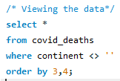
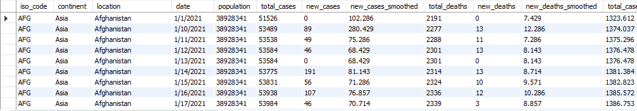
DATA PREVIEW
In this Project, we separate the dataset into two datasets- CovidDeaths and CovidVaccinations.
Covid_deaths table-

Slide 6

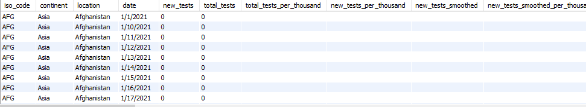
covid_vaccinations table-

Slide 7
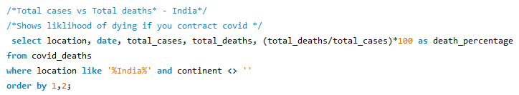
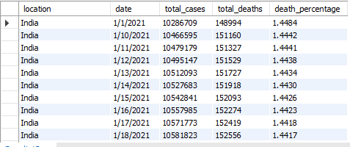
Total Cases vs Total Deaths (India)

Slide 8
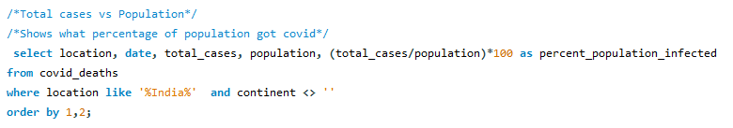
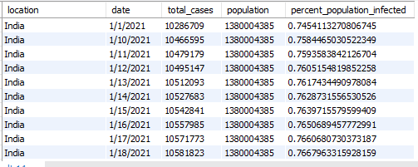
Total Cases vs Total Population (India)

Slide 9
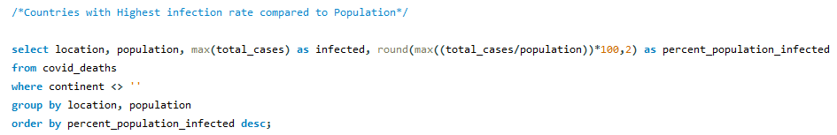
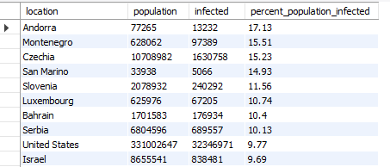
Countries with Highest Infection Rate

Slide 10
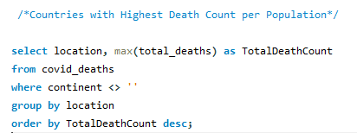
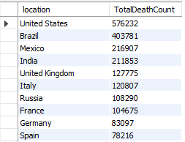
Countries with Highest Death Count per Population

Slide 11
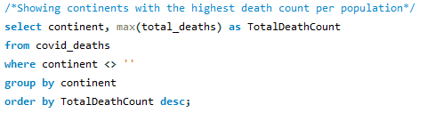
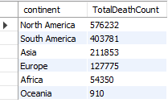
Continents with Highest Death Count per Population

Slide 12
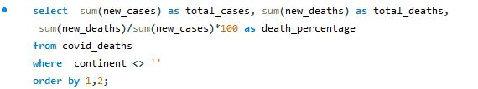

Global Numbers

Slide 13
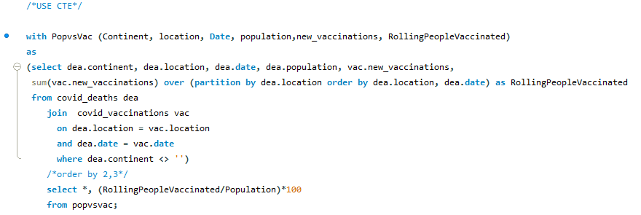
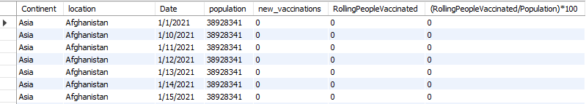
Total Population vs Vaccination
Using CTE

Slide 14
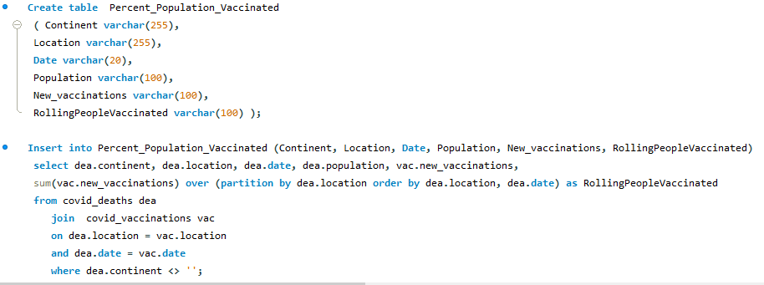

Using Temp Table

Slide 15
Thank You

